Slide 1


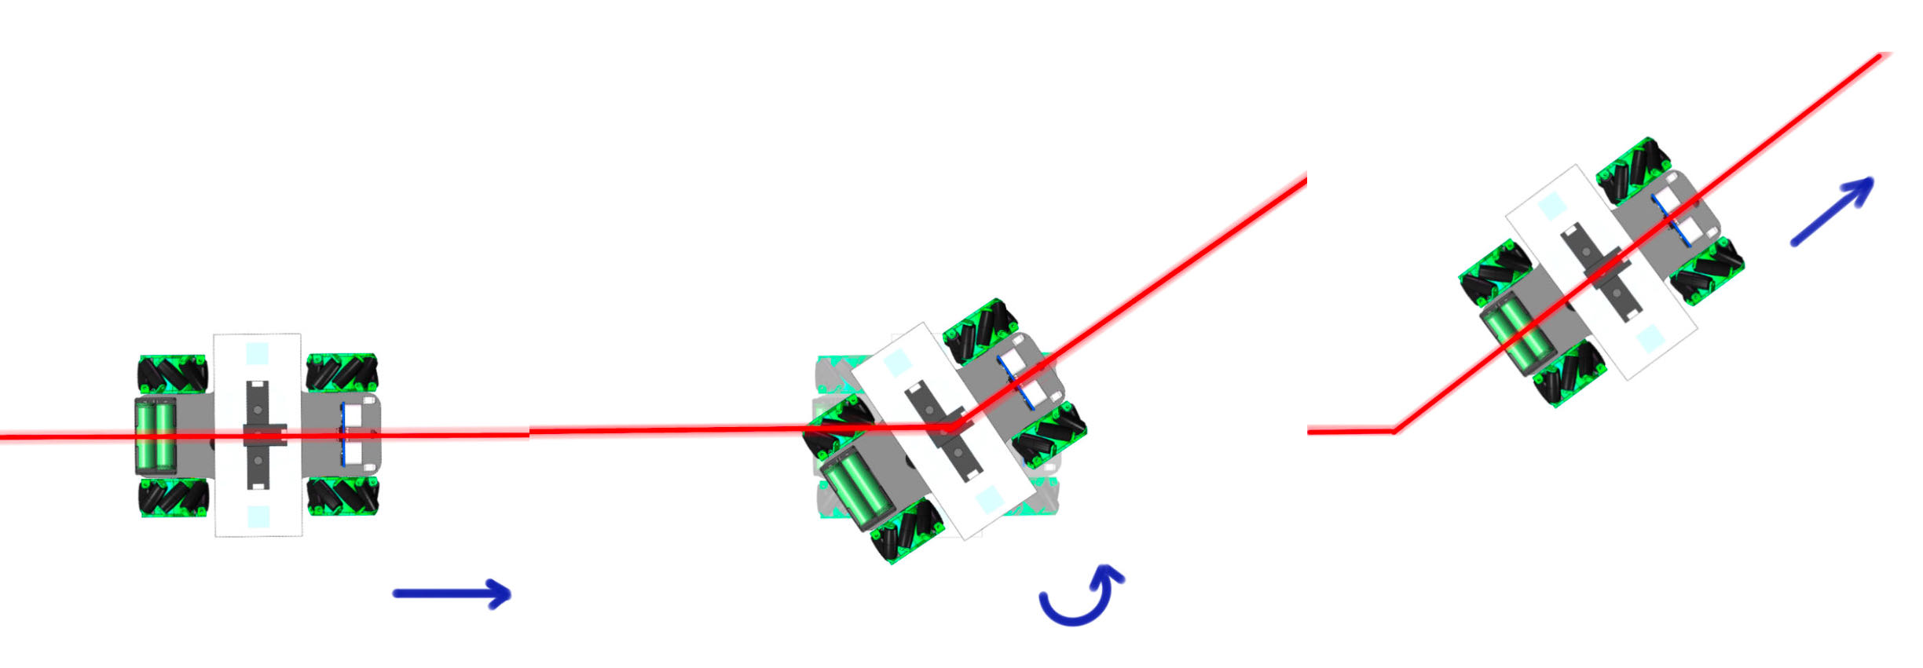
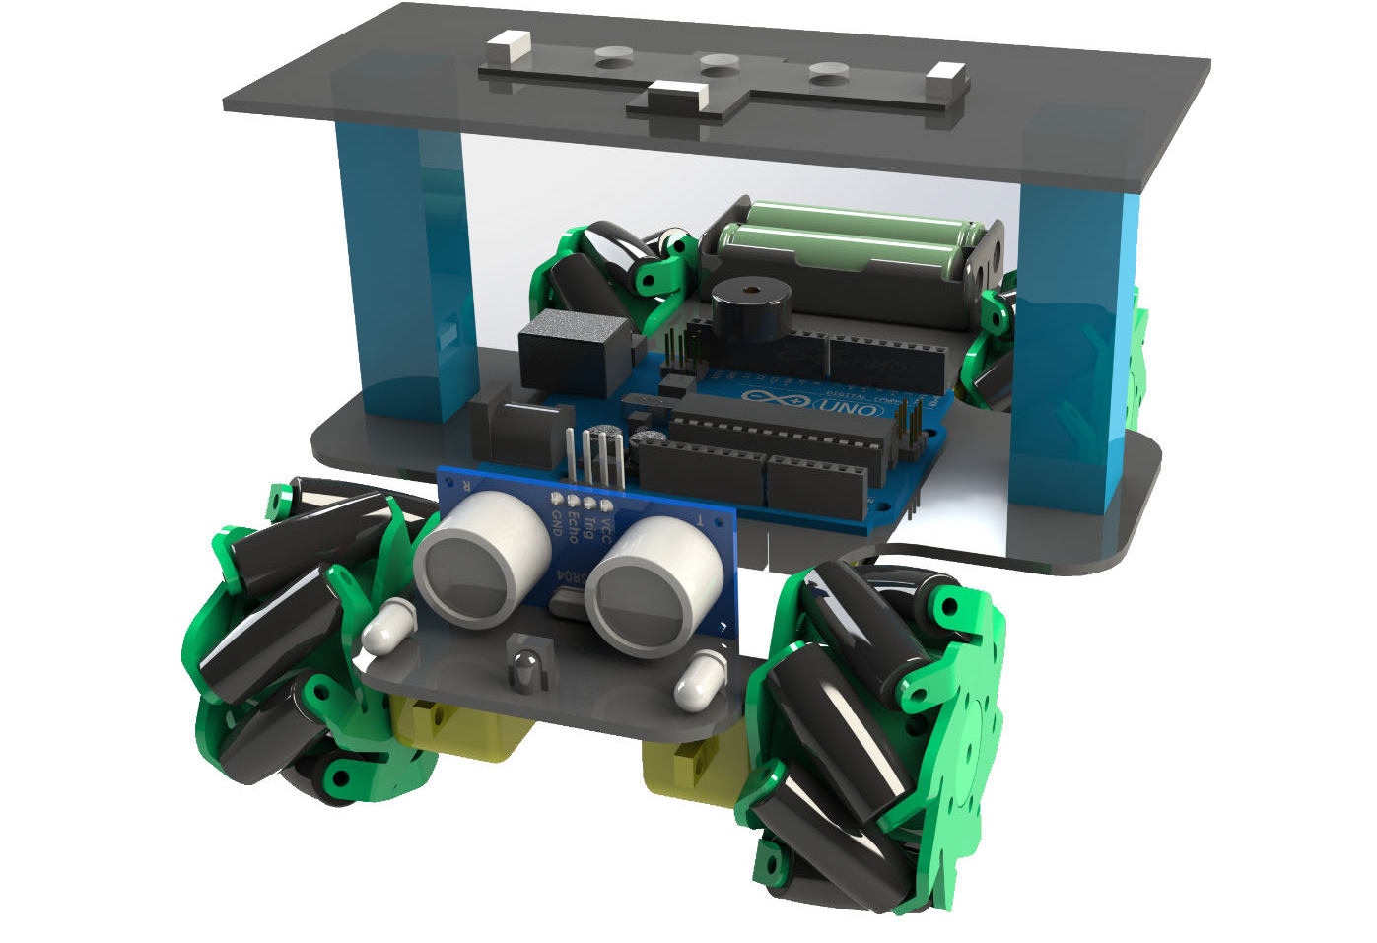
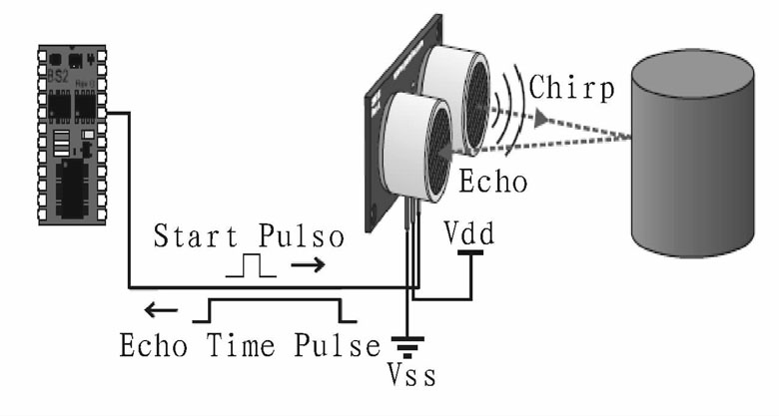
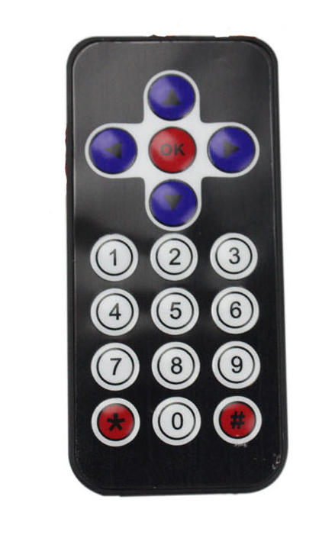
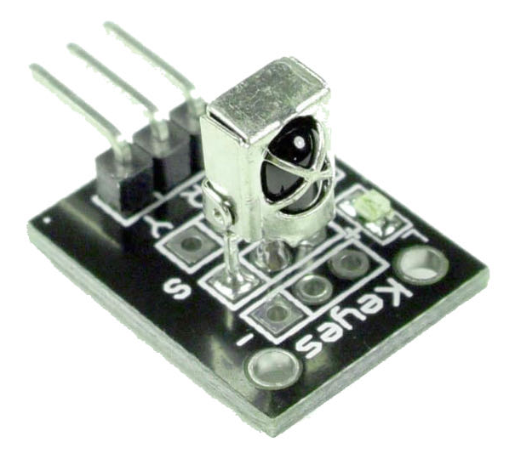
VG100 •Introduction to Engineering
Laser Tracking Mars Rover
Instructor: Prof. Yanfeng Shen, Prof. Ting Sun
Team Members: Kaiqi Zhu, Lubing Han, Xiang Li, Tianle Jiang, Linghui Zhou
Problem Statement
This project aims to arm the rover with the ability to cope with emergencies when automatic control systems break down or obstacles occur in its predetermined route.
Needs
A laser tracking system that detects designed routines and controls the rover to turn or stop according to the laser beam
An alerting system that beeps and halts the rover whenever an obstacle in range is detected
An infra-red remote control that controls the rover
Design Description
Fig. 1 Laser Tracing Rover
The laser tracking rover is composed of four parts: four Mecanum wheels, four photosensitive sensors, an ultrasonic sensor and an infrared sensor, all controlled by Arduino algorithms.
Each sensor corresponds to a function. For the photosensitive sensors, they can transform the laser signals to control the steering of the car. The ultrasonic sensor can send and receive ultrasonic signals, and it controls the rover to stop when an obstacle is detected to be in a particular distance[1]. And the infrared sensor, along with a remote control, can control the motion of the rover as an auxiliary function.
Significance of Solution
The laser beam is used to guide the direction of the probe, so that automatic tracking can be implemented on Mars. As long as the laser path is set, the rover can automatically follow the laser beams and reach the destination, thus saving both labour and resources, while also being able to cope with emergencies like power failures.
Fig. 2 Illustration of Laser Tracking
If there is an obstacle in a certain distance ahead, the rover can stop safely in time through ultrasonic ranging. And in order to remind attention to safety, the rover will automatically sound a sharp alarm.
Fig. 3 Illustration of Obstacle Alerting
When faced with an emergency, the infrared remote control plays an important auxiliary role. The rover can be controlled to choose the optimal path when there are multiple paths, and the route can be adjusted in time when the rover deviates from the original path.
Fig. 4 Units Used for Remote Controlling
Validation
According to relative test results, all specifications can be met.
The illumination intensity measured under laser-free condition is below 30 lx, and that in laser condition is beyond 700 lx (all measured in dark environment), ensuring the laser tracking system’s feasibility of detecting laser beams.
The longest detection distance of the ultrasonic sensor is measured to be 19.0 cm, and its critical distance to halt the rover is 3.0 cm, guaranteeing an appropriate range to alert and avoid obstacles.
The infrared remote control can control the rover successfully during the performance test.
Conclusion
The rover can cover designed routines by tracking the visible laser beams instantaneously, thus is able to be controlled even when automatic control system breaks down. Also, motions can be modified or ceased transiently by the infrared remote control when obstacles are detected and alerted by the alerting system. These functions comprise an artificial control system to cope with power failures or break down emergencies on Mars.
Acknowledgement
Professor Yanfeng Shen, UM-SJTU Joint Institute
Professor Ting Sun, UM-SJTU Joint Institute
Yongqi Zheng, Ziyang Xiong, Yan Lu, Ruizhe Wang, VG100 Teaching Assistants at UM-SJTU Joint Institute
Reference
[1] Zhen, L., “Research on laser path tracking technology of intelligent vehicles,” China Academic Journal Electronic Publishing House, 2012, pp. 3.
https://kns.cnki.net/KCMS/detail/detail.aspx?dbname=CMFD2012&filename=1012320388.nh

